Slide 1
New Automation Technology Beckhoff Automation

Slide 2
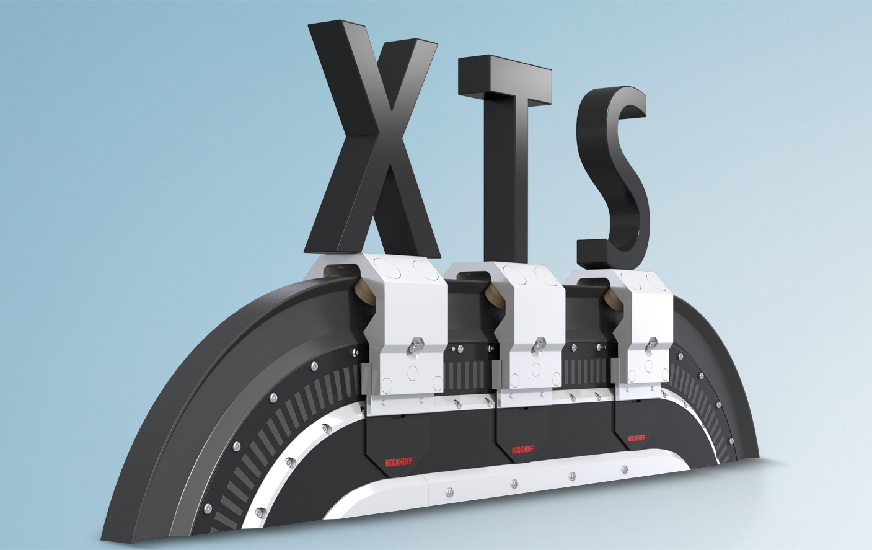
XTS Training

Slide 3
XTS – TcIoXtsProcessingUnit (XPU)

Slide 4
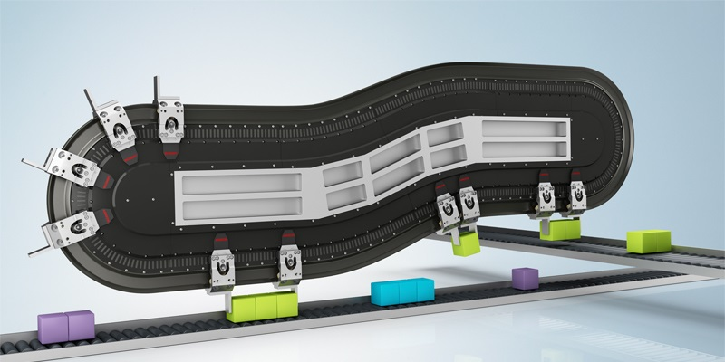
Agenda | XTS- TcIoXtsProcessingUnit (XPU)
XPU Introduction
XTS Configuration Process
XPU – Deep Dive
XTS Viewer
Mover 1
Simulation Mode

Slide 5
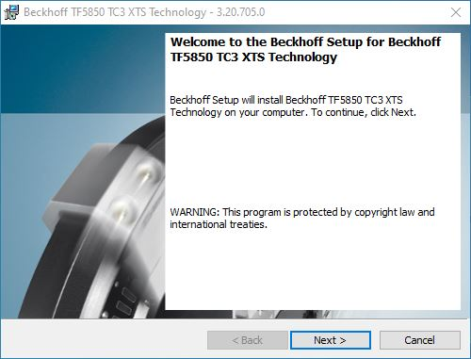
XPU Introduction
TcIoXtsProcessingUnit as TcCOM Module (TwinCAT Component Object Models
TF5850 | TC3 XTS Extension
Included TcIoXtsProcessingUnit
TcIoXtsDrv (obsolete)
SoftDrive
TF5400 | TC3 Advanced Motion Pack
Included
TC3 Collision Avoidance

Slide 6
XPU Introduction
TcIoXtsProcessingUnit is the link between the Motion and the hardware.
Motion
Axis
Is controlled as a typical PTP axis by the PLC.
SoftDrive
Represents the IO of the axis.
Contains the velocity and position control loops.
SoftDrive
{
Mover
Represents a mover.
Calculate an absolute position and write a current.
XPU
Module
Represents a motor-module.
Send the current setpoint toe the coils.
Hardware
Contains the current control loop.
Has many position sensors.
Devices

Slide 7
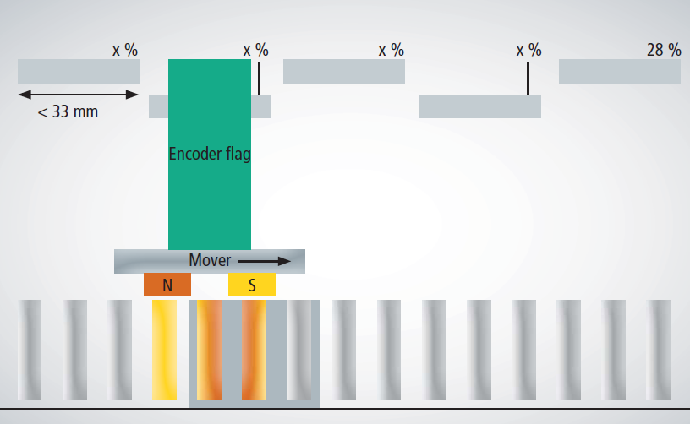
XPU Introduction
Collects the input channels of all terminals and calculates an absolute position for each mover. (It knows the XTS topology.)
Forwards the current output of the controller (SoftDrive) to the individual coils which are activated by a mover.
Handles module boundaries smoothly.
The abstract components of one XTS module

Slide 8
Agenda | XTS- TcIoXtsProcessingUnit (XPU)
XPU Introduction
XTS Configuration Process
XPU – Deep Dive
XTS Viewer
Mover 1
Simulation Mode

Slide 9
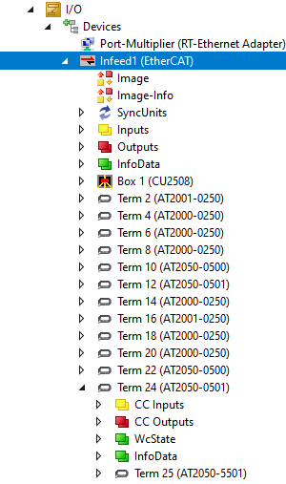
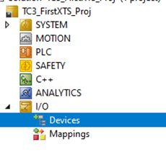
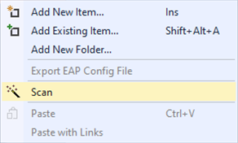
XTS Configuration Process...
Start with a new project.
Perform a ‘Scan’ of the IO…
TIP
After scan, change to Free-Run mode and have a look at the signals, the values should be changing continuously.

Slide 10
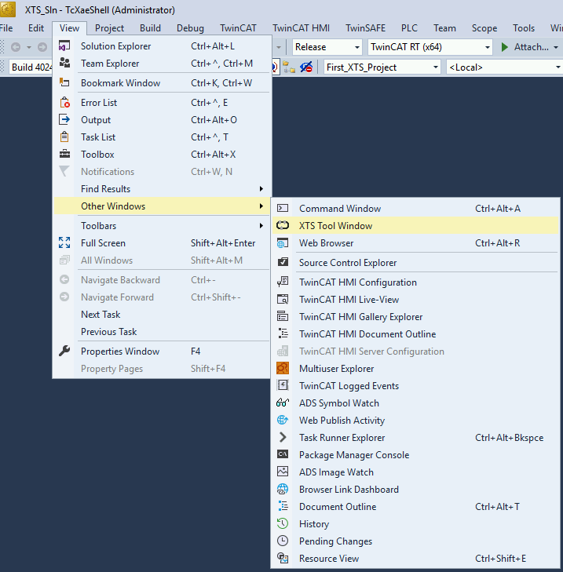

XTS Configuration Process...
Open XTS Tool Window

Slide 11
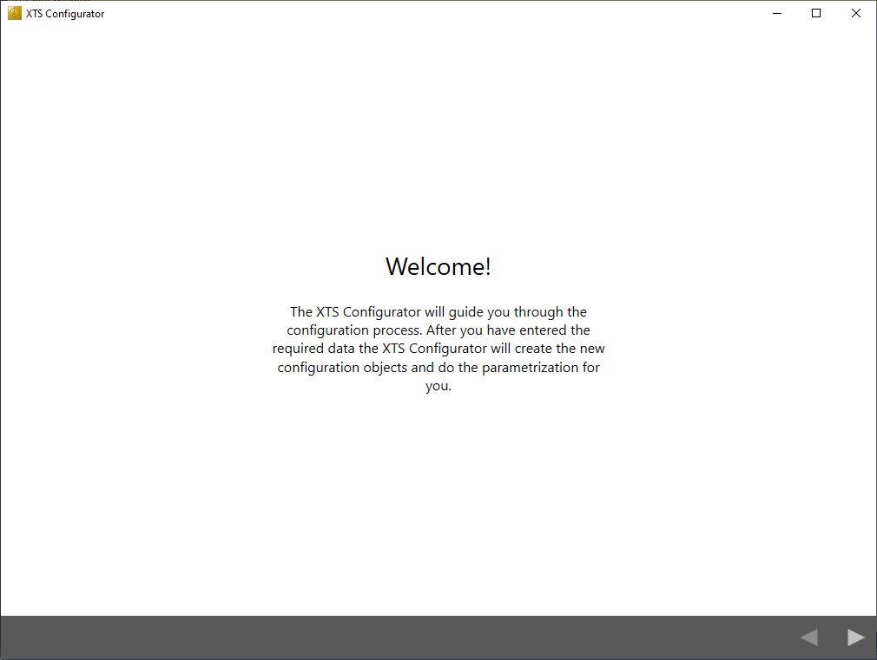
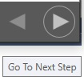
XTS Configuration Process...
Start the configuration process

Slide 12
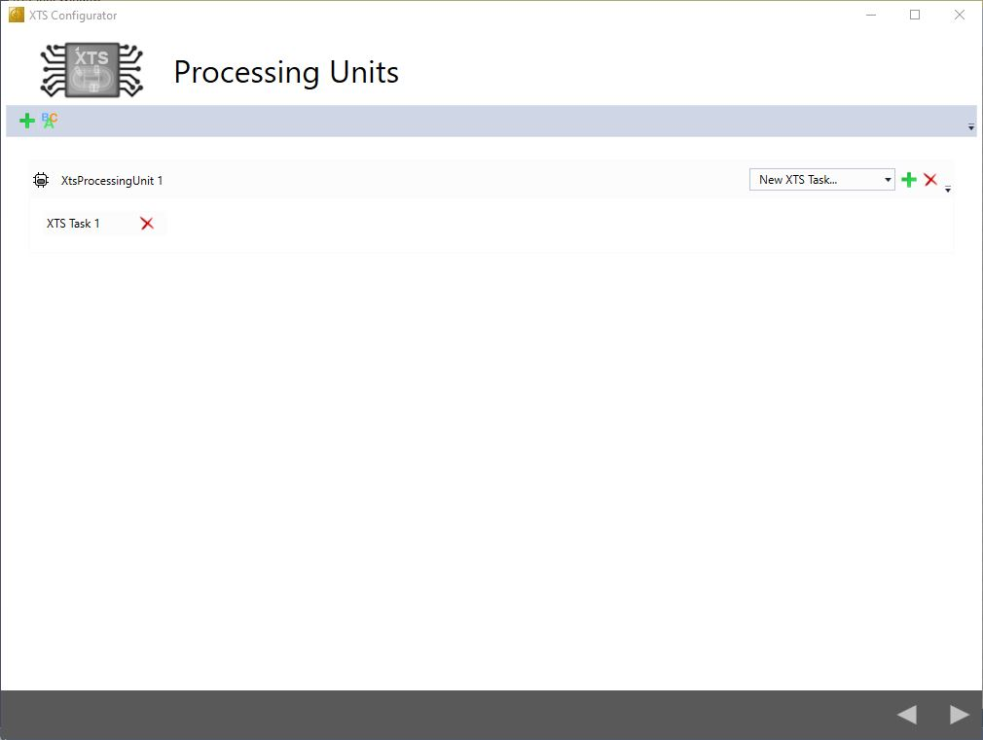
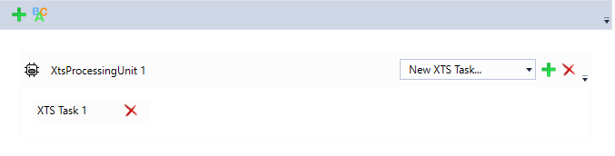
XTS Configuration Process...
Add XTS Task 1

Slide 13
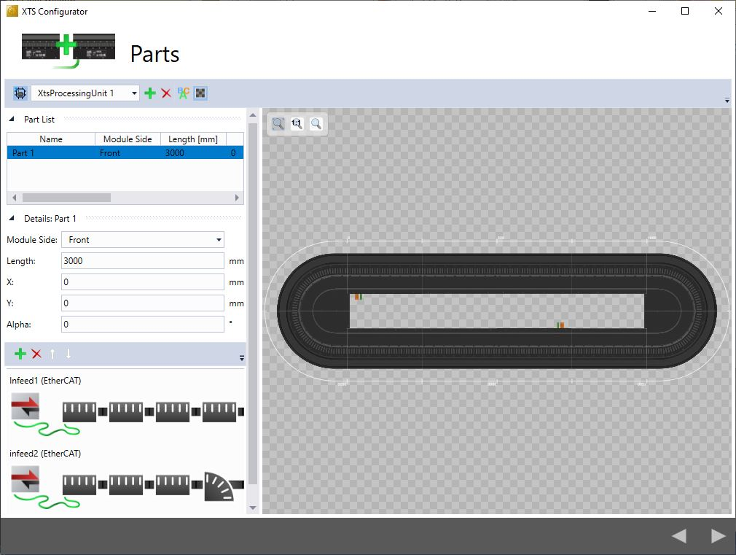
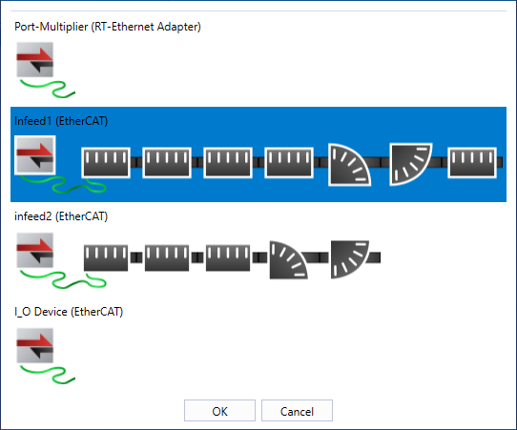
XTS Configuration Process...
Add XTS Parts

Slide 14
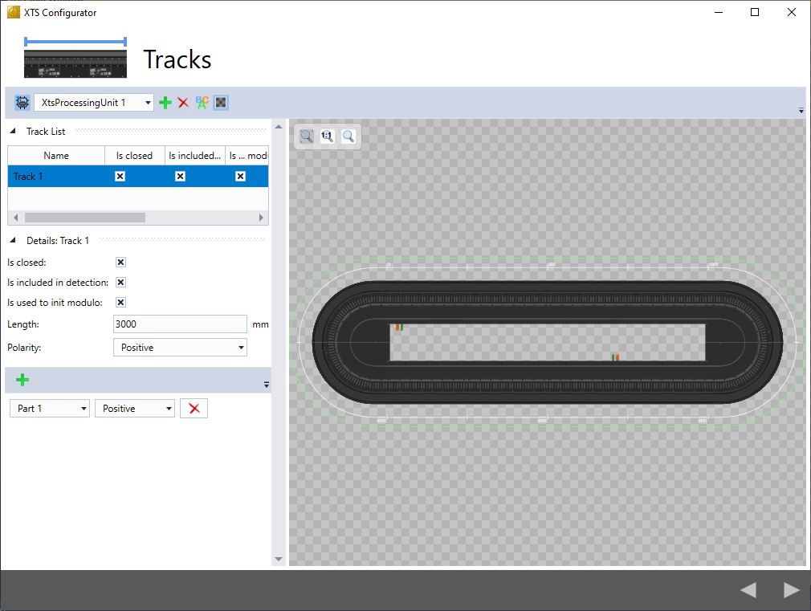
XTS Configuration Process...
Add XTS Tracks (one track minmum)
Add Parts to the track

Slide 15
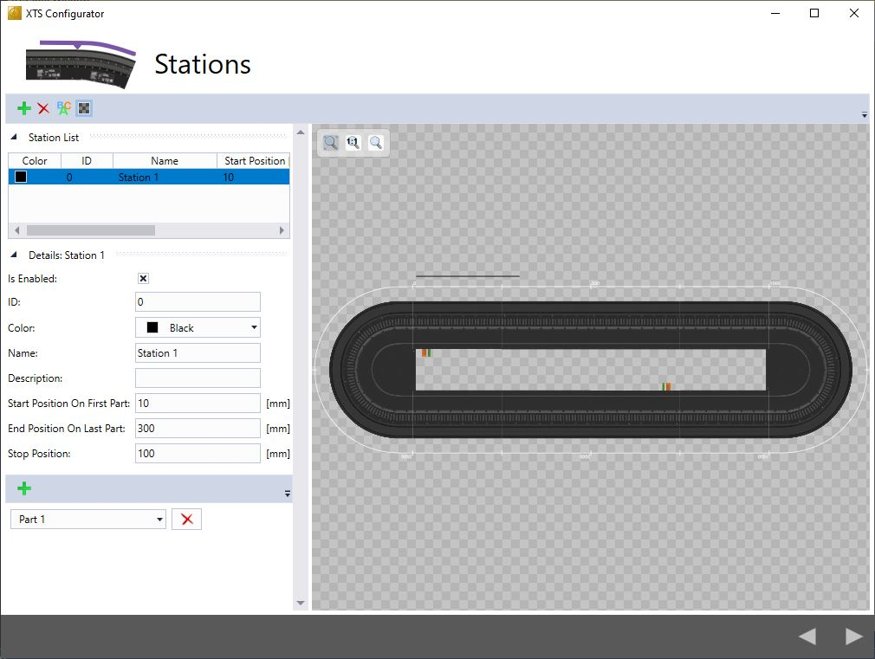
XTS Configuration Process...
Add XTS Station (only display at the moment)
Info
At the moment not necessary

Slide 16
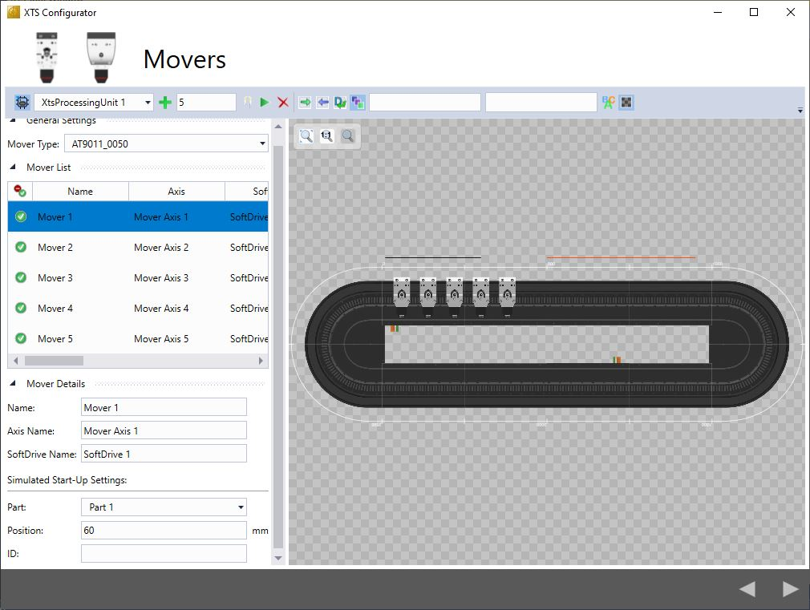
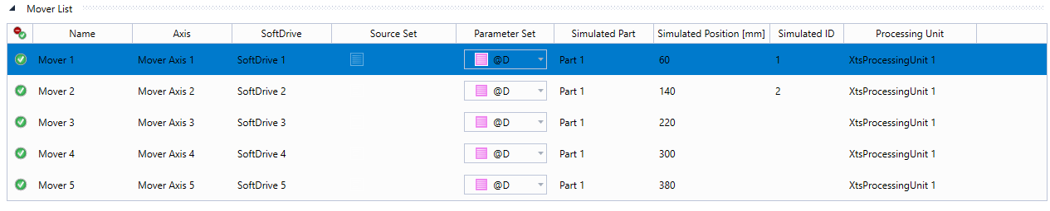
XTS Configuration Process...
Add XTS Mover

Slide 17
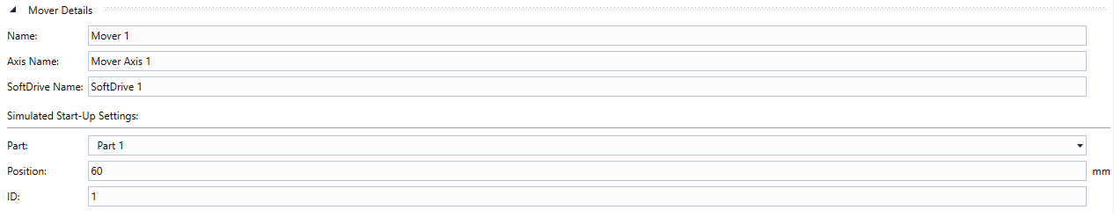
XTS Configuration Process...
Add XTS Mover
Mover List and Mover Details

Slide 18
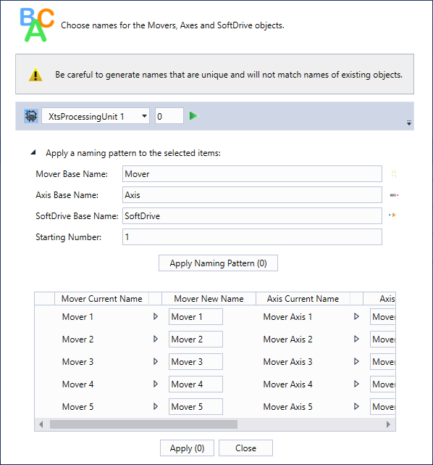
XTS Configuration Process...
Add XTS Mover
choose names for Mover, Axis and Softdrive

Slide 19
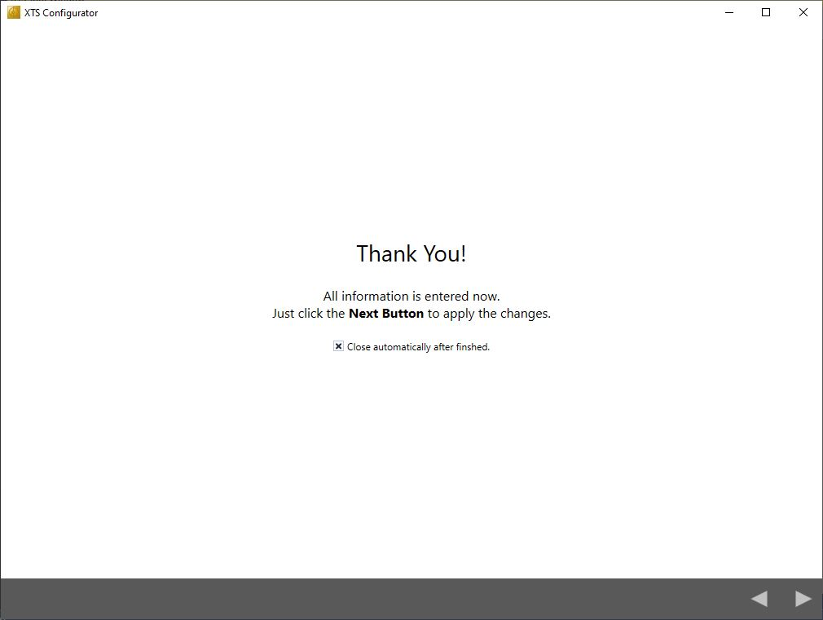
XTS Configuration Process...
Finished Configuration process

Slide 20
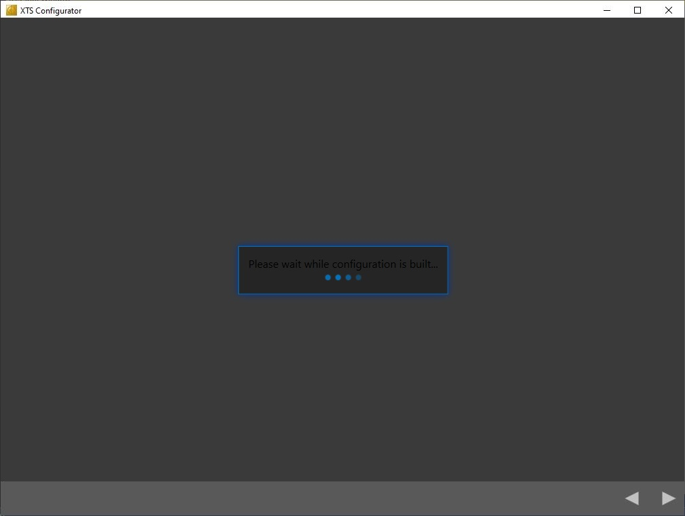
XTS Configuration Process...
Finished Configuration process
The manager creates the configuration of the system:
Creates the XTS task.
Creates the child objects of the TcIoXtsProcessingUnit (modules & movers)
Adds the Movers to the NC configuration (with a SoftDrive object for each mover)
Context (task) of all XPU objects and SoftDrive objects are set.

Slide 21
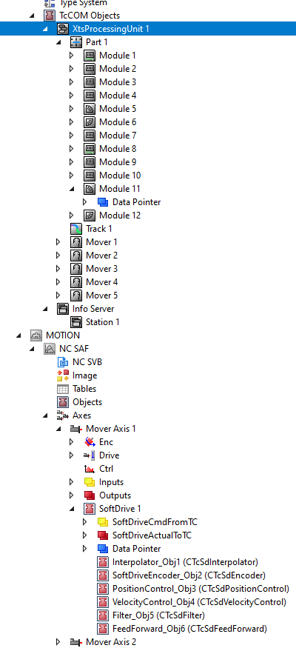
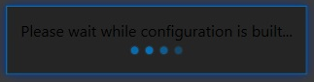
XTS Configuration Process...
Complete the configuration
Info
Module objects are linked with the IO.
Mover objects are linked with the SoftDrive.

Slide 22
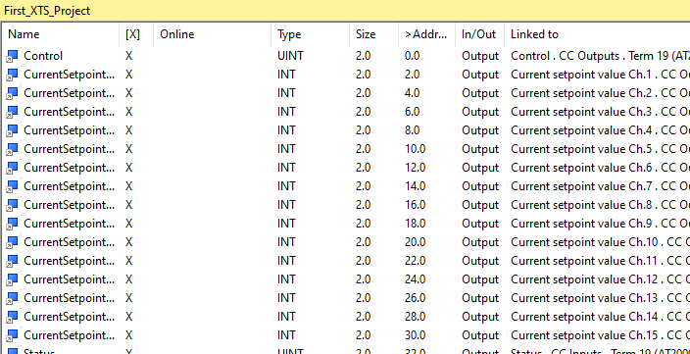
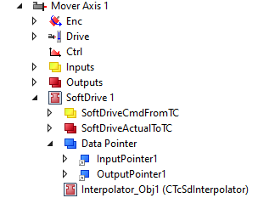
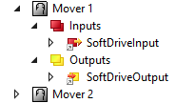
XTS Configuration Process...
Communication between the Modules:
via Data Pointers
No mapping object
No copy process
Warning
Use of data pointers is very fast but if used incorrectly data may be corrupted…

Slide 23
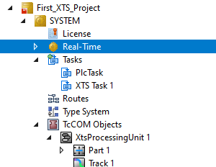
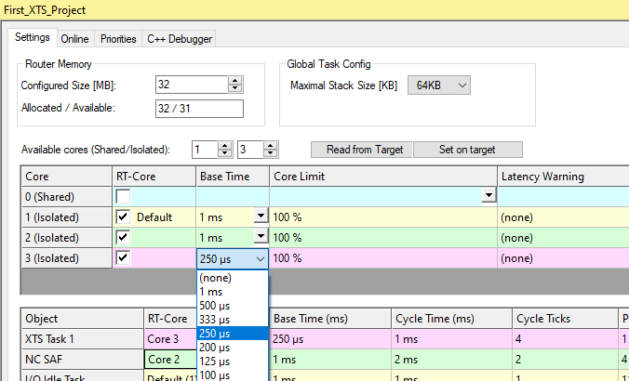
XTS Configuration Process...
Manual settings Real-Time
Change base time to 250 µs.
Change XTS task settings.

Slide 24
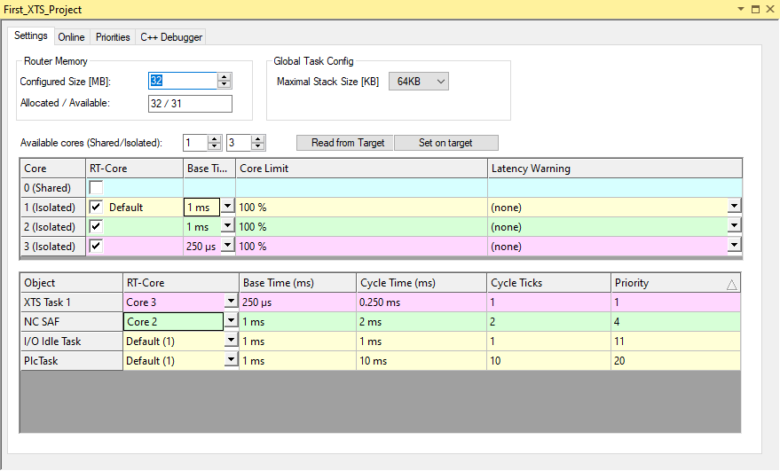
XTS Configuration Process...
Suggested settings Real-Time (small XTS-Systems)
It is suggested to use one core just for the fast 250 µs XTS task (100% isolated).
use 1 core just for windows and three cores as isolated real time cores

Slide 25
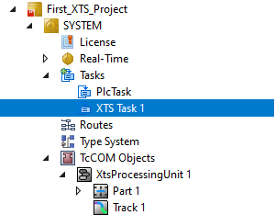
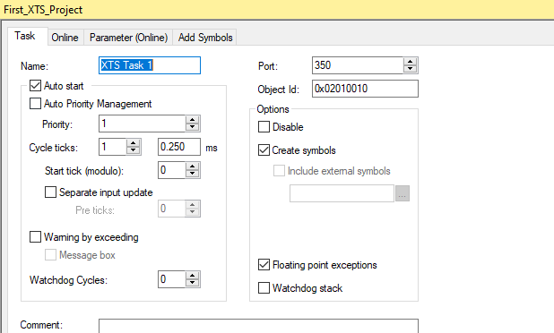
XTS Configuration Process...
Manual settings XTS Task
Change Cycle time to 250 µs
Port must be greater or equal to 350
‘Create symbols’ is useful to simplify measurements with TC3 Scope

Slide 26
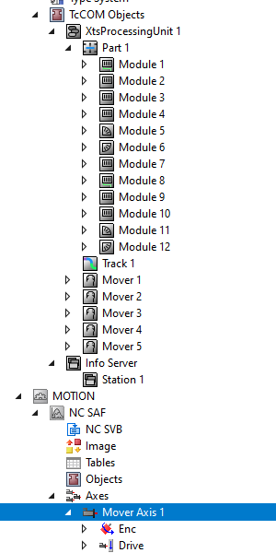

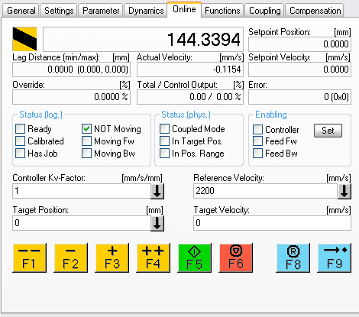
XTS Configuration Process...
First activation…

Slide 27
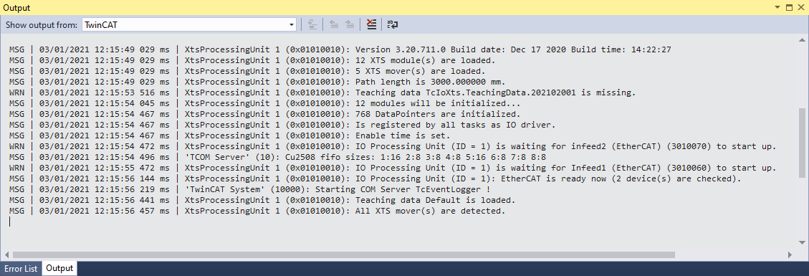
XTS Configuration Process...
First activation…
Output Window

Slide 28
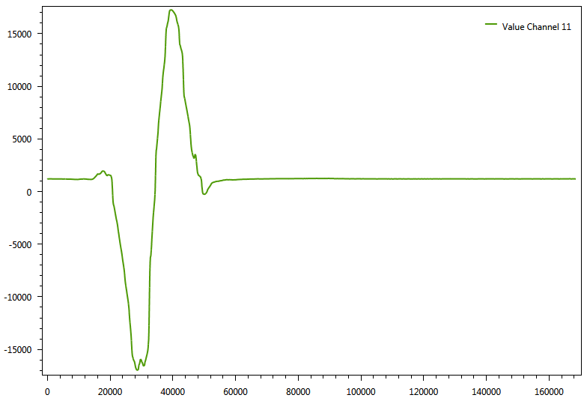
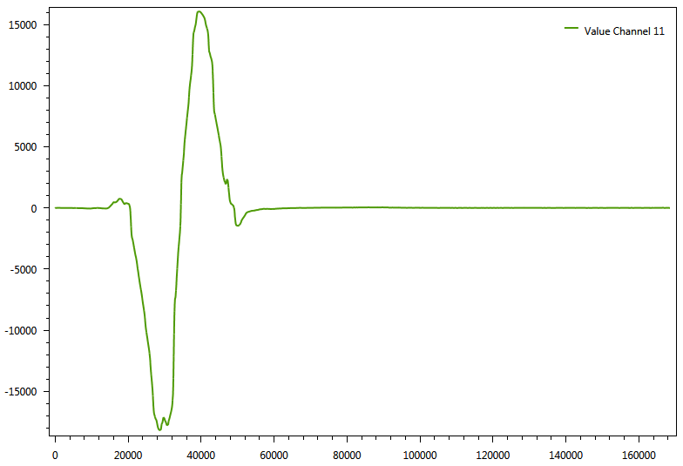
XTS Configuration Process...
Teaching Process
Analog position signal of an XTS-Module
Before
After

Slide 29
XTS Configuration Process...
Teaching Process
Before
After
Info
In the case of newer XTS-System (HW 18), the analogue offset sets are stored in the XTS modules.
A teaching process is not necessary

Slide 30
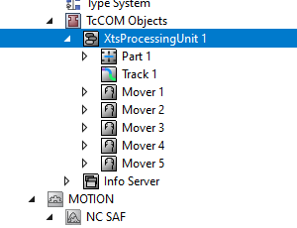
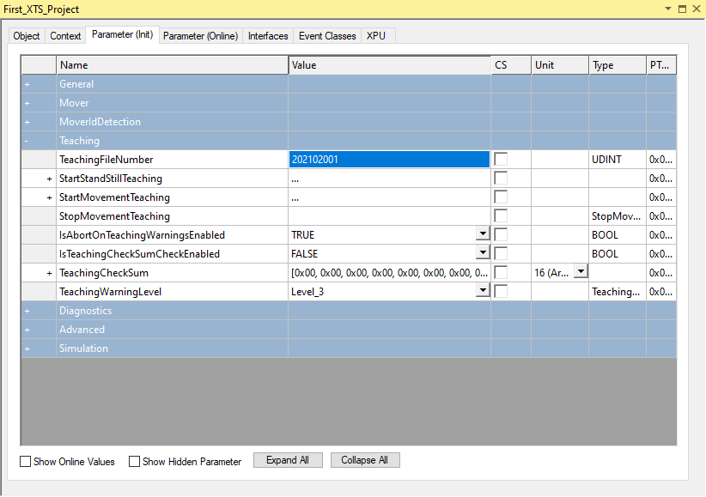
XTS Configuration Process...
Teaching Process | first Step
set a number for the teaching file which represents the current date.
Info
Changes to the ‘TeachingFileNumber’ are not recognized until after an ‘Activate Configuration’ is performed.
Before the teaching procedure is started, it must be activated so that the teaching data is saved in the correct file

Slide 31
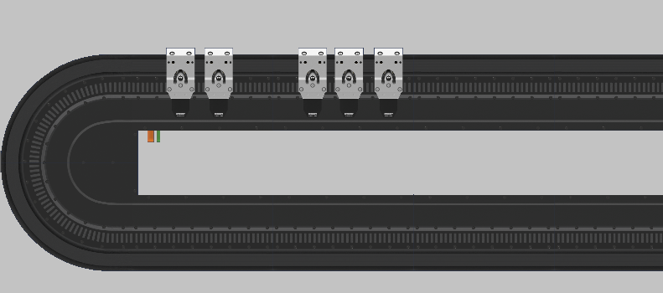
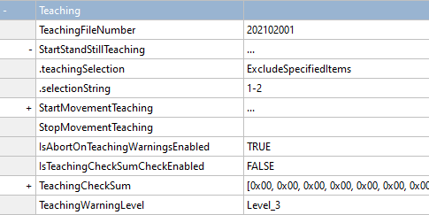
XTS Configuration Process...
Teaching Process | next Step
Move the Mover to a defined Position
Define Exclude Specified Items.
Info
.selectionString Format X, Y, Z or X-Z
Position
Module 1
Module 2

Slide 32
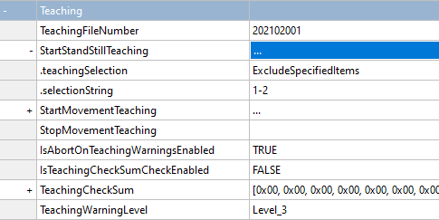

XTS Configuration Process...
Teaching Process | next Step
StartStandStillTeaching
Position
Module 1
Module 2

Slide 33
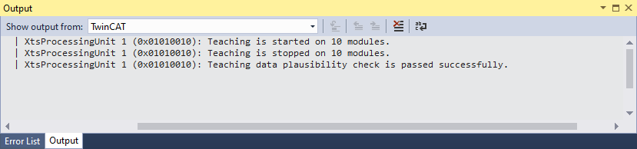
XTS Configuration Process...
Teaching Process
Teaching Stops automatically
Position
Module 1
Module 2

Slide 34
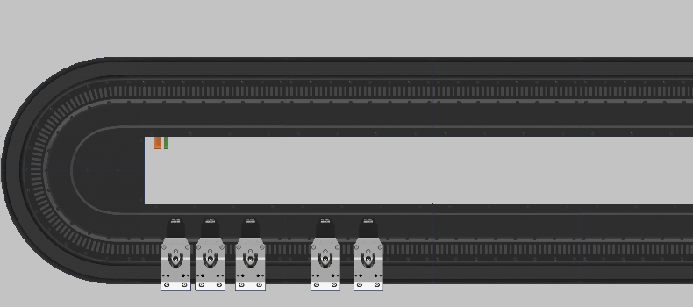
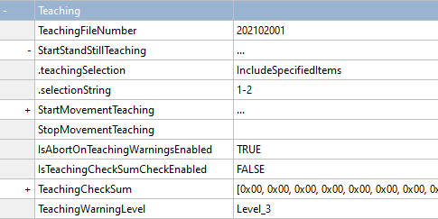
XTS Configuration Process...
Teaching Process | next Step
Move the Mover to a different defined Position
Change “.teachingSelection”
Warning
Do not place movers at crossings where the module is active during teaching. Otherwise the feedback system will not work correctly.
Position
Module 1
Module 2

Slide 35
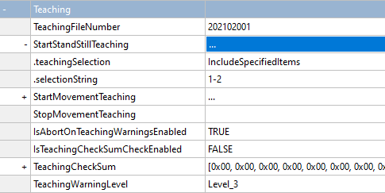
XTS Configuration Process...
Teaching Process | next Step
StartStandStillTeaching
Position
Module 1
Module 2

Slide 36
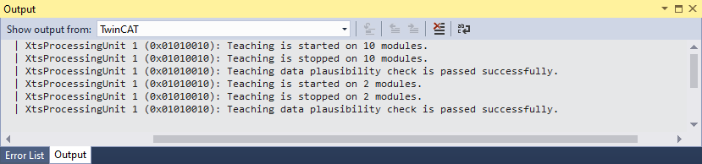
XTS Configuration Process...
Teaching Process
Teaching Stops automatically
Position
Module 1
Module 2

Slide 37
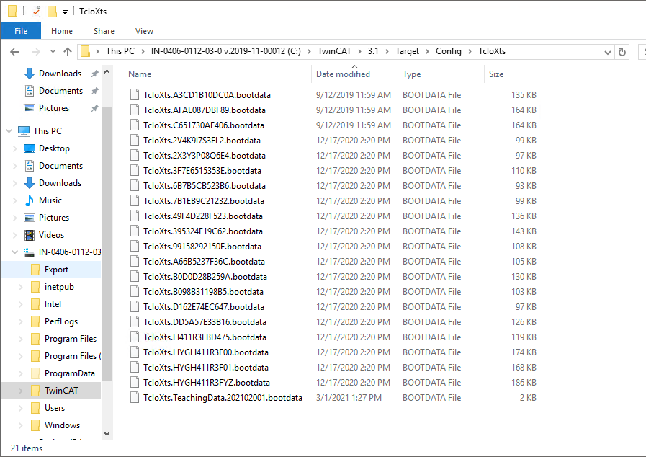

XTS Configuration Process...
Teaching Process
Set TwinCAT in Config Mode
Advice: Make a backup after the teaching file is created the first time

Slide 38

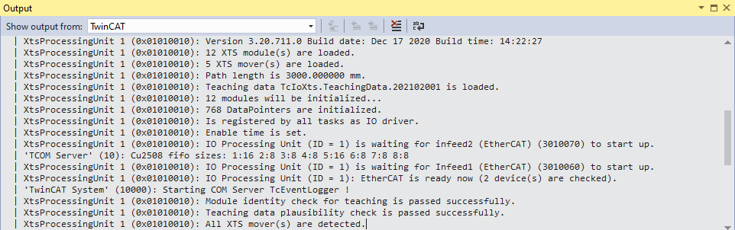
XTS Configuration Process...
Teaching Process
Set TwinCAT in Run-Mode

Slide 39
Agenda | XTS- TcIoXtsProcessingUnit (XPU)
XPU Introduction
XTS Configuration Process
XPU – Deep Dive
XTS Viewer
Mover 1
Simulation Mode

Slide 40
XPU - Deep Dive
TcIoXtsProcessingUnit is the link between the Motion and the hardware.
Motion
Axis
Is controlled as a typical PTP axis by the PLC.
SoftDrive
Represents the IO of the axis.
Contains the velocity and position control loops.
SoftDrive
{
Mover
Represents a mover.
Calculate an absolute position and write a current.
XPU
Module
Represents a motor-module.
Send the current setpoint toe the coils.
Hardware
Contains the current control loop.
Has many position sensors.
Devices

Slide 41
XPU - Deep Dive
Cycle Update of SoftDrive & Axis
NC-SAF Task (2ms)
XTS Task (250 µs)
Axis 1
Axis 2
Axis 3
Axis 4
SoftDrive 1
SoftDrive 2
SoftDrive 3
SoftDrive 4
Mover
XPU
Module
Input / Output Update
EtherCAT
AT2000-0250
AT2000-0250
AT2000-5250
AT2000-5250

Slide 42
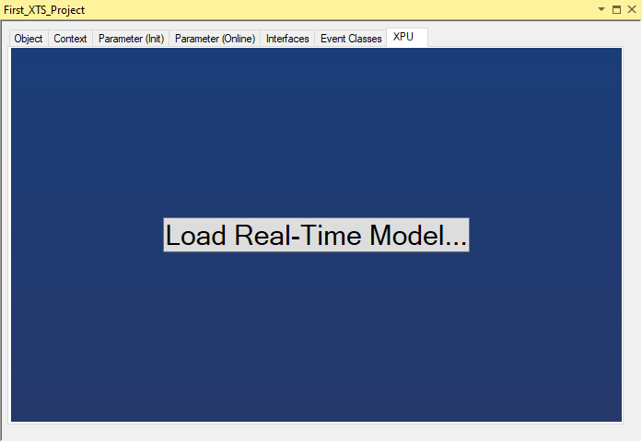
XPU - Deep Dive
Real-Time Model
click on Load Real-Time Model…

Slide 43

XPU - Deep Dive
Real-Time Model
Show the act. Real-Time Model
Can use to adjust (better via Configurator)

Slide 44


XPU - Deep Dive
Real-Time Model
Create XTS Task 2 via Configurator

Slide 45


XPU - Deep Dive
Real-Time Model
Setup Real-Time

Slide 46


XPU - Deep Dive
Real-Time Model
Setup XTS Task 2

Slide 47

XPU - Deep Dive
Real-Time Model
new setup
Info
This setup should not be used in a real machine. It is only an example.

Slide 48

XPU - Deep Dive
Real-Time Model

Slide 49


XPU - Deep Dive
Diagnosis
output Window from Visual Studio

Slide 50


XPU - Deep Dive
Diagnosis
Module Diagnostic History

Slide 51

XPU - Deep Dive
Diagnosis
Parameter (Online)

Slide 52


XPU - Deep Dive
Diagnosis
Info's from EL9576 (Break Chopper Terminal)

Slide 53

XPU - Deep Dive
Error Moverdetection
Too few movers detected

Slide 54

XPU - Deep Dive
Error Moverdetection
Too many movers detected

Slide 55

XPU - Deep Dive
Error Moverdetection
Too few movers detected
Too many movers detected

Slide 56


XPU - Deep Dive
Collecting data…
XTS-DUMP

Slide 57






XPU - Deep Dive
Collecting data…
XTS-SupportAssistant

Slide 58

XPU - Deep Dive
Collecting data…
XTS-SupportAssistant

Slide 59
Agenda | XTS- TcIoXtsProcessingUnit (XPU)
XPU Introduction
XTS Configuration Process
XPU – Deep Dive
XTS Viewer
Mover 1
Simulation Mode

Slide 60


XTS Viewer
XTS Viewer
Start

Slide 61


XTS Viewer
XTS Viewer
Toolbar 1
choose Target
connect to selected target
continuous update
open sup window

Slide 62

XTS Viewer
XTS Viewer
Toolbar 2
choose a view description
Start / Stop view
select module side and rotation degree

Slide 63

XTS Viewer
XTS Viewer
Complete view

Slide 64



XTS Viewer
XTS Viewer
Show Mover Positions (Modulo Value)

Slide 65
Agenda | XTS- TcIoXtsProcessingUnit (XPU)
XPU Introduction
XTS Configuration Process
XPU – Deep Dive
XTS Viewer
Mover 1
Simulation Mode

Slide 66

Mover 1
Mover 1 functionality
The purpose of the Mover 1 detection is to identify a mover as a main mover and to distinguish it from the subsequent movers.
This offers then advantage of a clear correlation between mover hardware and software axis.

Slide 67
Mover 1
Mover 1 functionality
Therefore one Mover with a special magnetic plate set is used (Mover1).
These magnets creates an inverted magnetic field.
This magnetic plate set exhibits a different behavior when the Mover1 search is triggered (MoverIdDetection)

Slide 68
Mover 1
MoverldDetection
When MoverldDetection is trigger, all Movers make a small movement like "Wake and Shake".
Therefore 48V power supply is required.

Slide 69

Mover 1
MoverldDetection
The mover detection across all movers is controlled via the TcloXtsProcessingUnit (XPU) object.
You have the option to apply general detection parameters
and to trigger the Mover 1 search manually.

Slide 70

Mover 1
MoverldDetection
To use Mover ld detection the parameter "MoverldDetectionMode“ has to change to "Mover1 ".
When a Mover with the certain magnetic plate
is on the Track, this Parameter has to be
setup.
Otherwise this leads to unforeseen
movements of the mover.
Unforeseen movements can lead to injuries to
people and damage to tools and the
machine.

Slide 71


Mover 1
MoverPositionAssignment
The absolute Position is setup regarding this
parameter.
lf the Parameter is set to "StartAtMover1"
the mover has the lowest or highest position,
dependent and the sorting order.

Slide 72
Mover 1
MoverldDetectionMode
MoverPositionAssignment
Change of these parameters requires at TwinCAT
→ Activate Configuration

Slide 73

Mover 1
TriggerMoverIdDetection
By selecting the parameter
"TrigerMoverldDetection" and
,via right Mous-Click, download the
Parameter,
the Mover 1 detection is triggered manually

Slide 74


Mover 1
Feedback Mover Id detection
Massages from the Mover ld detection
→ shown in the Output Window
State of Mover ld detection
→ as Parameter in "Parameter (Online)"

Slide 75
Agenda | XTS- TcIoXtsProcessingUnit (XPU)
XPU Introduction
XTS Configuration Process
XPU – Deep Dive
XTS Viewer
Mover 1
Simulation Mode

Slide 76


Simulation Mode
Simulation Mode
Change Parameter „OperationMode“
Setup Mover Simulation parameter
Deactivate I/O Devices
Activate Configuration

Slide 77
Simulation Mode
Simulation Mode
Setup Mover Simulation parameter

Slide 78

Simulation Mode
Simulation Mode
Simulation Mode Parameter

Slide 79

XTS | New Freedom in Machine Building
Complex sequences – simplified solution: XTS

Slide 80
Training material
This training material is provided to complement the presented training content. Outside the actual training the material may only be used for internal purposes at the company of the course participant. In addition, the material or extracts thereof may be used in end customer training for products containing Beckhoff products, or for presentations, provided the presentation refers to Beckhoff products. Extracts or copies of the training material must contain the following copyright acknowledgement: “© Beckhoff Automation GmbH & Co. KG”.
The same applies to extracts from presentation material. The user of the material is solely responsible for the completeness of extracts and copies. It is explicitly not permitted to offer commercial or free training for Beckhoff products. This applies to training with and or without the training material. The training material must not be edited, manipulated or modified.
Passing on of the aforementioned rights to third parties is not permitted.
Beckhoff Automation GmbH & Co. KG

Slide 81
02/2021

